Slide 1
Introduction to
Contact Lenses
Haleh Ebrahimi, OD
Clinical Assistant Professor
University of Pittsburgh Medical Center

Slide 2
History of Contact Lenses
1508 – Leonardo DaVinci - sketches of lens-enclosed liquid reservoir to optically neutralize the cornea
1636 - Rene Decartes – creased a telescope to correct myopic blur and improve vision
1887 – F. A. Muller – created the first scleral contact lens for patient with recurrent corneal ulcer
1888 - Adolf Eugene Fick – reports using scleral contact lens to correct ammetropia
1888 – E. Kalt (French Optician) – reports fitting scleral contact lens to correct Keratoconus
1889 – August Muller – Publishes doctoral thesis on correcting high myopia using scleral contact lenses
1946 – Kevin Tuohy – Develops corneal PMMA lens (files patent in 1948)
PMMA lens ultimately replaced by Rigid Gas Permeable lens because of its impermeability to Oxygen

Slide 3
History of Contact Lenses
1963 Otto Wichterle and Dr. Drahoslav masde first soft contact lens called HEMA (hydroxyethyl methacrylate)
1968 FDA classifies all contact lenses as Drugs
1971 first FDA approved daily wear contact lens
1978 - The Medical Devices Act of 1976 reclassifies hydrogel contact lenses as medical devices
1987 Disposable lenses were introduced to United states
1999 modern Silicone Hydrogel Lenses entered market
2001 FDA expanded this approval to a maximum of 30 day wear, based on safety evidence outside of the US

Slide 4
Terminology

Slide 5


Lens Power
Contact lenses, although physically thin, are optically thick
The disparity between Back Vertex Power and Front Vertex Power increases with thickness, therefore it becomes more significant in Plus than in Minus
Clinically significant at ≥ + 10.00 D (aphakic patients)

Slide 6
Surface Power
Surface power of the cornea is measured indirectly by measuring the corneal radius and converting to diopters based on an index of refraction of 1.3375
  F= n’- n / r
  n’ = 1.3375
  n=1 (air)
Keratometry
Important for converting keratometry and base curve values in RGP lenses

Slide 7
Contact Lens Terminology
Flexture
  rigid lenses generally do not conform to the shape of the cornea; hydrogel lenses generally do
  contact lens flexure is a term used to describe conformity
Effectivity
  the position of the correction lens (or “vertex distance”) affects the power required to optimally correct for the patient’s refractive error at distance
  this becomes clinically significant at 4.00D
  each meridian should be calculated separately
  F’= F/ (1-dF)

Slide 8
Accommodation
The position of the correcting lens also affects the power required to optimally correct for the patient’s refractive error at near, although not by the same magnitude
Accommodation with a contact lens approximates that of an emmetrope
This becomes clinically significant at >3.00D
Therefore the following relationship exists,
  Accommodative demand is GREATER for a contact lens wearing MYOPE than for a spectacle wearing myope
  Accommodative demand is LESS for a contact lens wearing HYPEROPE than for a spectacle wearing hyperope
Clinically significant for early presbyopes

Slide 9
Prism and Contact Lenses
Prismatic Effects
  Contact lenses minimize the prismatic effects encountered when the eye is not looking through the optical center of the lens
  Usually this is desirable – occasionally it is not
Prism in Contact Lenses
  Prisms are used in contact lenses for stabilization purposes and rarely to correct for vertical deviations (up to 2.5pd theoretically of imbalance)
  P=h(BVP)
    P= prismatic power in prism diopters
    H = distance from optical center in cm
    BVP = back vertex power

Slide 10
Spectacle Magnification
Spectacle magnification is the ratio of the image size of the corrected ametrope to the retinal image of the same eye uncorrected
For spectacle wearing myope, the image size is reduced; for spectacle-wearing hyperope, the image size is enlarged when compared to the uncorrected eye
Contact lens wearing myopes often report that the image is clearer because the retinal image is larger
Relative spectacle magnification, however, refers to the comparison of the retinal image to an emmetropic eye
In this case, axial refractive errors result in the same magnification as the emmetropic eye when corrected with spectacles.
This theory suggests that axial refractive error should NOT be corrected with contact lenses (Knapp’s Law)

Slide 11
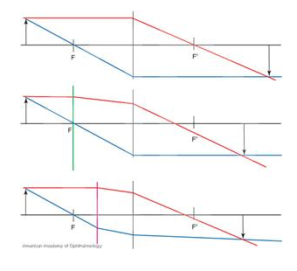
Knapp’s Law
States that lenses placed at the anterior focal point of the eye, generally 17mm in front of the eye, will create similarly sized images on the retina, whenever the disparity between the two eyes is due to a difference in axial length of the eyes

Slide 12
Physical Properties of Materials
Oxygen Permeability (Dk) – In this nomenclature,
    D is the diffusion coefficient – a measure of how fast dissolved molecules of oxygen move within the material – and
    k is a constant representing the solubility coefficient or the number of oxygen molecules dissolved in the material.
  This is a physical property.
  It is defined as the rate of oxygen flow under specified conditions through unit area of contact lens material of unit thickness when subjected with unit pressure differences
  How much O₂ the lens allows to go through
  High Dk materials do not always give the oxygen performance on the eye that would be expected from a laboratory result. Corneal swelling is equivalent to that of a lens with a Dk only 55% of the measured value

Slide 13
Physical Properties of Materials
Oxygen Transmissibility (Dk/t) – where
  t is thickness of the lens or sample material.
  This is not a physical property, but a specific characteristic related to the sample thickness.
  For a particular lens under specified conditions defines the ability of the lens to allow oxygen to move from the anterior of the lens to the posterior of the lens.
  Calculates Thickness with Dk
  Thickness varies with power and location on the lens

Slide 14
Physical Properties of Materials
Wettability is the ability of a drop of liquid to adhere to a solid surface.
    The lower the cohesive forces within a liquid, the greater the attraction between the fluid and surface.
    Thus, superior wettability enhances the spread of liquid over a surface.
    The Contact angle is the measure of the hydrophilicity of a surface. The lower the contact angle, the more wettable the surface.
  Provides patient comfort and uniform distribution of water over contact lens surface

Slide 15
Contact Lens Types
Rigid Gas Permeable lenses (RGP)
Polymethyl methacrylate (PMMA)
Soft Lenses
  Silicone Hydrogels
  Biocompatible lenses
  Silicone Lenses

Slide 16
Patient Motivation for Contact Lens Wear
Cosmesis
Convenience
  Ex. Monovision in presbyopes
  Ex. No glasses sliding down face
Improved vision
  Myopia – increased retinal image size
  Hyperopia and Amblyopia – decreased aberrations and prismatic effects
Sports
Hobbies
Occupation

Slide 17
Relative Contraindications
Allergies
Dry Eye
Compromised Cornea (exception: Bandage Contact Lens)
Medications (that create dry eye)
  Antihistamines, diuretics, tri-cyclic antidepressants, oral contraceptives
Systemic conditions (that cause healing issues)
  -Diabetes, thyroid, Lupus, Rheumatoid Arthritis, pregnancy
Monocular patients
  Amblyopia or Trauma – they have only “1 good eye” if something goes wrong
Environment
  Dust (rigid lenses),
  Chemicals (soft lenses soak up fumes)

Slide 18
Refractive Information
Corneal Shape
  Keratometry
  Autokeratometry
  Photokeratoscope
  Placido Disc
  Topography – Axial and Tangential
Spectacle refraction
  Consider vertex distance of ≥4.00
Calculated residual astigmatism

Slide 19
Hydrogel Lens
Design and Fitting
Initial Base Curve Selection
  0.40-0.60mm FTK for smaller OAD (12-13mm) or 0.60mm FTK for larger OAD (14-15mm)
    Flatter for larger diameter lenses because of sagittal depth
    Ex. K: 42.65/45.00@70
      (Assume 14mm OAD) Convert flat K to mm (7.89 mm), add 0.60mm – 8.49
  4D FTK
    4D Flatter than K = 38.75
    Convert to mm of radius with the following equation 0.3375/38.75 = 8.71
  Average K Readings = 41.00-45.00
    Fit with middle BCR → most hydrogel lenses are available in 1 to 4 BCR
    Ex, average K readings use middle BCR; if available in 8,4, 8.7, 9.0 use 8.7mm
  Manufacturer guidelines
  Clinical Experience

Slide 20
Hydrogel Lens
Design and Fitting
Diameter
  (Horizontal - visible Iris Diameter)
  1 mm larger than HVID
  0.5-2.00mm acceptable
Power
  Spherical equivalent
    2.00-0.50x180, initial lens -2.25D
  Vertex Distance
    -4.00DS spectacle Rx; initial ilens -3.75D
  Over-refraction (ORx)
    Trial lens = -2.75D, over refraction = -0.50D, final lens power = -3.75
    Trial lens = -3.00D, over refraction = -4.00D, final lens power = (-3.00-3.75) = -6.75

Slide 21
Evaluation of
Soft Contact Lenses
Coverage
  0.50mm coverage 360° minimum
  Recording “complete” vs “incomplete
Centration
  Avoid flare or distortion
  Recording:
    “good centration” or “slightly temporal decentration but adequate
    “poor centration” or “excessively inferior decentration”

Slide 22
Evaluation of
Soft Contact Lenses
Movement
  0.50-1.00mm in primary gaze
    Usually more in superior gaze
  Material and thickness dependent
    A thin lens may move less
    Expectations vary with material
    A wrinkle or bubble in the lens means a tight fitting lens
    If a lens falls, then the lens is too loose
  Recording
    “adequate”, “inadequate”, “Excessive”,
    May be described qualitatively or quantitatively
  Push up test
    Used to assess movement of lens when movement is marginal
    Technique: Push on the lower lid
      If CLs resist, then (-) push up test
      If CLs moves easily, the (+) push up test

Slide 23
Brand CL | Manufacturer | Material/ H2Ocontent | dK Value | Replacement Schedule | Base Curve | Diameter | Price (6 month supply)/ eye
Acuvue Oasys* | Johnson & Johnson (Vistakon) | SiHy with UV Blocker, 38% | 103 | 2 weeks DW (1 week EW) | 8.4,8.8 | 14.0 | $80 ($320/yr)
Acuvue 2 | J&J | Hydrogel, 58% | 28.0 | 2 week DW | 8.3,8.7 | 14.0 | $60 ($240/yr)
Biofinity | Coopervision | SiHy, 48% | 128 | Monthly (DW/EW) | 8.6 | 14.0 | $55 ($220/yr)
Proclear | Coopervision | Hydrogel, 62% | 27.0 | Monthly DW | 8.2,8.6 |  | $50 ($200/yr)
Air Optix | Alcon | SiHy, 33% | 110 | Monthly (DW/EW) | 8.6 | 14.2 | $55
Air Optix Night & Day* | Alcon | SiHy, 24% | 140 | Monthly EW (FDA approved to stay in for 30 days and nights) | 8.4, 8.6 | 13.8 | $100 ($400/yr)
Purevision* | Bausch and Lomb (B&L) | SiHy, 36% | 91 | Monthly | 8.3,8.6 | 14.0 | $60
Ultra | B&L | SiHy, 46% | 114 | Monthly DW | 8.5 | 14.2 | $65 ($260/yr)
Biomedics 55 | Coopervision | Hydrogel, 55% | 33.0 | 2 Weeks DW | 8.6 | 14.0 | $35
Fresh Look Color | Alcon | Hydrogel, 55% | 16.1 | 2 Weeks DW | 8.6 | 14.5 | $60
Air Optix Color | Alcon | SiHy, 33% | 110 | Monthly DW | 8.6 | 14.2 | $85 ($340/yr)

Slide 24
Brand CL | Manufacturer | Material/ H2Ocontent | dK Value | Replacement Schedule | Base Curve | Diameter | Price (90 pack)/ eye
Dailies Total 1 | Alcon | SiHy 33% | 140 | Daily | 8.5 | 14.1 | $95 ($760/yr)
Dailies Aquacomfort Plus | Alcon | Hydrogel, 69% | 26 | Daily | 8.7 | 14.0 | $90 ($720/yr)
Soflens Dailies | Baush & Lomb | Hydrogel, 59% | 22 | Daily | 8.6 | 14.2 | $90
Proclear 1 Day | Coopervision | Hydrogel, 60% | 25.0 | Daily | 8.7 | 14.2 | $90
MyDay | Coopervision | Sihy, 54% | 80 | Daily | 8.4 | 14.2 | $95
Clariti 1 Day | Coopervision | SiHy, 56% | 60 | Daily | 8.6 | 14.1 | $70 ($560/yr)
Acuvue 1 Day Moist | J&J | Hydrogel, 58% | 28.0 | Daily | 8.5, 9.0 | 14.2 | $90
Acuvue Oasys 1 Day | J&J | SiHy, 38% | 103 | Daily | 8.5, 9.0 | 14.3 | $115 ($920/yr)

Slide 25
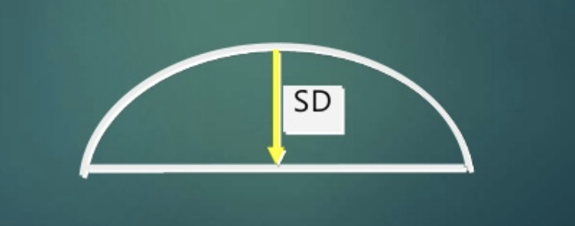
Problem Solving
Fitting Relationship Relating to Sagital Depth
  Sagital depth is the distance from the center of the base curve to the horizontal flat surface
  Base curve is the same for D2 and D3 but D2 has larger sag depth
  If the lens diameter ⬆, then sag depth ⬆ = a tighter lens
  If the lens diameter ⬇, then sag depth ⬇ = a looser lens
Fitting Relationship Relating to Base Curve Radius
  Steeper BC = tighter fit (smaller in mm, larger in Diameter)
  Flatter BC = looser fit (larger in mm, smaller in diameter)

Slide 26
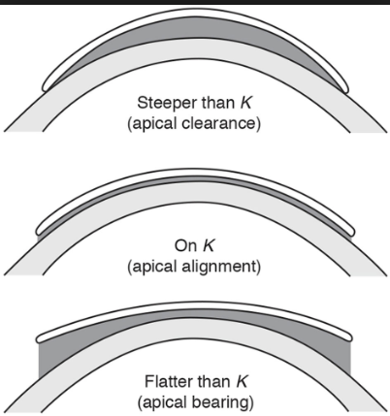

Slide 27
Dispensing and Follow up
Recommended Testing (assuming dispensing and fitting is not the same)
  Entering Vas with pinhole
  Biomicroscopy
  Lens insertion
  Visual acuity
  Over refraction (spherical if ≥ 20/20)
  Lens fit evaluation
    Coverage
    Centration
    Movement

Slide 28
Dispensing and Follow Up
Patient information
Informed consent
  Disclosing all abnormalities
  Risk of proposed treatment plan
  Alternative treatment options
Hygiene & cosmetic use prior to lens handing
Lens case care (rinse, air dry, replace monthly)
Wearing schedule (“4+2”)
Lens care instructions
Lens insertion, removal, recentering
Spectacle as a backup
Recall
After hours contact

Slide 29
Lens Care Components (CRADLE = Care, Rinse, And Disinfect Lenses Everyday)
Daily Cleaner – removes loosely bound foreign matter, usually with a surfactant
Rinse- removes daily cleaner, loosened deposits, microorganisms or to rinse after overnight storage
1. Saline
  Formerly preserved with Thimersol (mercury based) which is often toxic to the cornea → preservatives today are less toxic to varying degrees (sorbic acid, potassium sorbate, polyquad, and biguanide (dymed))
  Unpreserved formerly made with distilled water & NaCl tablets (“home-made”) → discontinued because its use was associated with serious ocular infection (Acanthamoeba Keratitis)
  Unpreserved saline is available today via 1) unit dose vials, 2) aerosol containers 3)special buffering system with anti-microbial activity
2. Multipurpose Solution with common preservatives
  Timersol, sorbic acid, benzyl alcohol, polyaminopropyl biguanide (PAPB)/Dymed, Polyquad, Aldox, polyhexanide

Slide 30
Lens Care Components
Disinfectants – kill or deactivates potentially pathogenic organisms
Chemical
  Preservatives may be toxic to the eye
  May be used on all lens types & has little effect on life of the lens
  Surfactant cleaning is an important precursor to disinfection
  Chemical disinfection has a negligible effect on acanthamoeba
  Most prevalent today
Oxidative
  Proven efficacy (well documented)
  Eliminates preservative sensitivities
  Some patients may experience irritation from residual peroxide
  CDC condoned as effective against AIDS/HIV virus
Thermal (Heat)
  Disinfection -- 80°C for 10 min – does NOT kill spores
  Steriliazation -- 121°C for 15 min at 15 psi wen the lens is manufactured – Kills spores

Slide 31
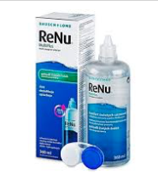
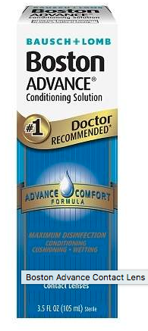
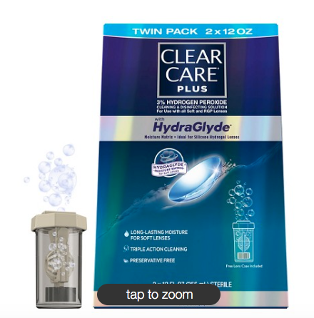
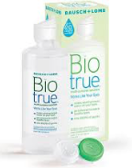
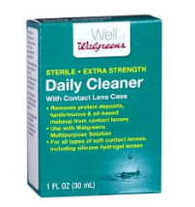
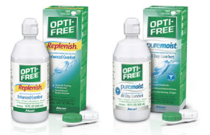

Slide 32
Rewetting drops
Utilized with symptomatic patient
Recommend with extended wear
Do not substitute with cleaning lenses
Functions
  Rehydrates lens
  Alleviates discomfort
  Flushes debris from the lens & eye

Slide 33
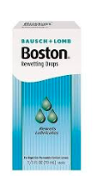
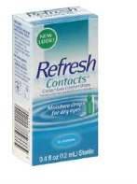
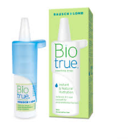
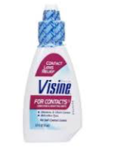
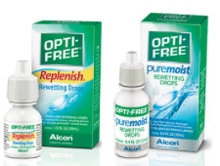

Slide 34
Cleaning lenses for Part time wearers
Clean and disinfect at least every 30 days (recommended by manufacturers) – realistically should be every week
Lens Storage case – replace periodically (CDC recommends every 3 months)
Clean and disinfect within 24 hours of reapplication
Identify which lens care system are better for long-term storage

Slide 35
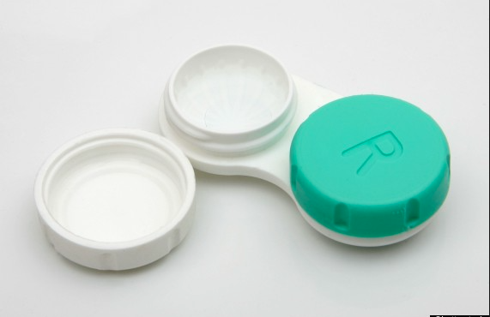
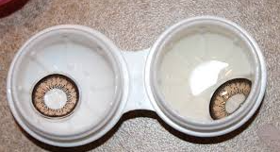
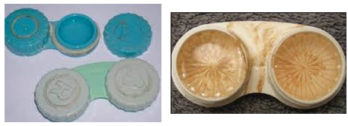

Slide 36
Clinical pearls of Lens care system
Conventional wear – consider periodic cleaners and/or oxidative
Planned replacement/2 weeks or more frequent – multi-purpose solution
Patients with allergies – oxidative (hydrogen peroxide); use with preservative free saline
Patients with protein deposits – periodic cleaner or more frequent replacement
Patients with lipid deposits – alcohol based cleaner or more frequent replacement

Slide 37
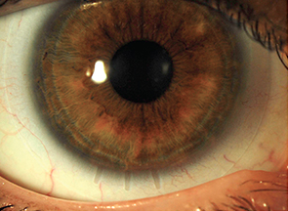
Astigmatic Compensation
A pneumonic device for compensation of axis for astigmatic contact lens correction is “LARS”
It is measured from the vantage point of the practitioner viewing the patient and always related to the SPECTACLE prescription (vision correction) rather than the trial lens
LARS = Left Add Right Subtract
Remember 1 clock hour = 30°

Slide 38
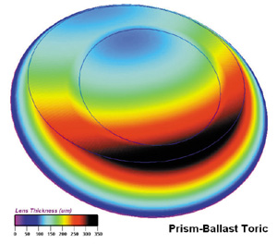
Lens Stabilizing Techniques (soft toric CL)
Prism Ballasting
  Thick part on bottom, more common
  stabilizing technique
  “watermelon seed effect” – upper lid squeezes of the lens
    Adv: better with oblique axis
    Disadv: lens thicker inferior, reduces O2 transmission
Truncation
  Less truncation (1mm) for smaller diameter lenses
  Larger truncation (1.5mm) for larger diameter lenses
  Tends to loosen the fit of the SCL

Slide 39
Lens Stabilizing Techniques (soft toric CL)
3. Dynamic Stabilization (“double thin zones”)
  thick center, thin on the edges by lids & lids keep it in place
  Adv: lens remains thin overall, good edge comfort with thin edges
  Disadv: careful SLE to assess orientation
4. Periballasting – like prism ballasting but no prism on visual axis
5. Back toricity vs Front Toricity
  Use back surface toric SCL for toric cornea patient
  Use front surface toric SCL for lenticular astigmatism Pt
6. Larger overall diameter
  Good stabilizing technique when used with 1 of the other techniques

Slide 40
Board Question
You are fitting a patient with a soft toric contact lens. His refraction in the right eye is -2.50-1.25x090. You happen to have this exact contact lens and place it on the patient. You note that he mark indicating the 6 o’clock position is in the 4 o’clock position. Which of the following contact lens prescriptions should you order for this patient?
-2.50-1.25x120
-2.50-1.25x150
-2.50-1.25x030
-2.50-1.26x060

Slide 41
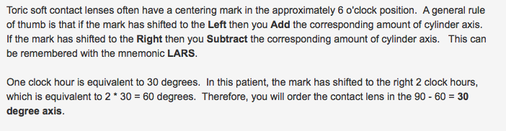

Slide 42
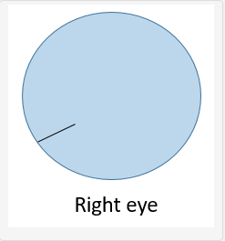
Board Question
A patient with a manifest refraction of -2.00-1.00x030 is fitted with a toric soft contact lens with astigmatic axis of 30 degrees. On slit lamp exam of the right eye, the contact lens is well-centered but the 6 o’clock marking is actually located at the 8 o’clock position. What axis of the contact lens should be ordered for this eye?
  30 degrees
  60 degrees
  90 degrees
  150 degrees

Slide 43
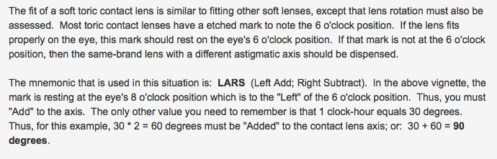

Slide 44
Bandage Contact Lenses
Applications: Facilitate wound healing, Provide mechanical protection, Reduce discomfort, Maintain proper surface hydration, Deliver medication, Improve Visual function
Specific Examples:
lid abnormalities – such as entropion, trichiasis, tarsal scars
corneal pain relief – in bullous keratopathy, epithelial corneal erosion or abrasion, filamentary keratitis, Postoperative penetrating keratoplasty
chronic epithelial defects such as neutrophic corneas and chemical burns
Post surgical uses such as PRK, sealing leaky wounds as splint or sealant beneficial after cataract, penetrating keratoplasty or glaucoma filtering surgery.
Piggy Back with GP fitting lens

Slide 45
Therapeutic selection:
  Hydrogel
  Silicone elastomer
  Silicone Hydrogel
  Rigid Gas Permeable (typically Scleral lenses)
Hydrogel Examples:
  Kontur – large OAD (15-16mm) conventional hydrogel lens “off label” use, Can make up to 24mm diameter lens, Large helps it move less
FDA Approved Silicone Hydrogel lenses
  Air Optix Night and Day (approved 30 consecutive nights)
  Acuvue Oasys (approved 7 consecutive nights)
  Purevision (approved 30 consecutive nights)

Slide 46
Contraindications of Bandage Contact Lens Use
history of vegetative matter (don’t bandage possible fungal infection)
Contact lenses wearer (pseudomonas concern)
Active infection
Immunologically incompetent
Poor hygiene
Significant lid dysfunction
Uveitis
Ocular surface disease (indication or contraindication?)
Corneal hypoesethesia (indication or contraindication?)
Post operative Cornea (indication or contraindication?)

Slide 47
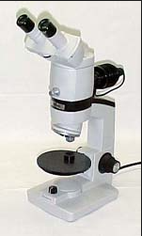
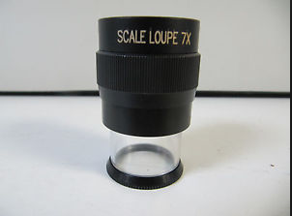
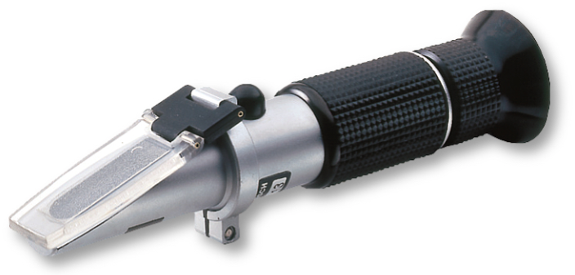
Devices for Contact Lens Verification
Power (F) with the Lensometer
Overall Diameter (OAD) – measured with Loupe
Base Curve Radius (BCR) and Center Thickness (CT) with the Radiuscope
  RGP only
Water content (%) with the Refractometer

Slide 48
Fitting RGPs
Information required
Accurate refraction
Accurate keratometry readings
Horizontal Visible Iris Diameter
Vertical Palpebral aperture
Pupil size in average and low illumination

Slide 49
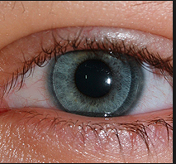
RGP Lens Selection
Starting Point for Lens Diameter
  OverAllDiameter (OAD) = 9.2mm
    Average starting value
  Optic Zone Diameter (OZD) = 7.80mm
  Diameter = HVID – 2.3mm (alternative)

Slide 50
Bennett Base Curve Radius
Corneal Cylinder | Initial Base Curve Selection
0.0-0.50D | 0.50-0.75 FTK
0.75-1.25D | 0.25-0.50 FTK
1.50D | On K
1.75-2.00D | 0.25 STK
2.25-2.75D | 0.50 STK
3.00-3.50D | 0.75 STK
Ex. If K’s are 43.00/43.00 → 0.50 Flatter = 42.50D
Ex. If K’s are 40.00/42.50 → 2.5 D corneal cyl → 40 + 0.50STK = 40.5

Slide 51
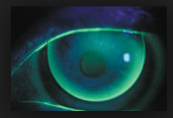
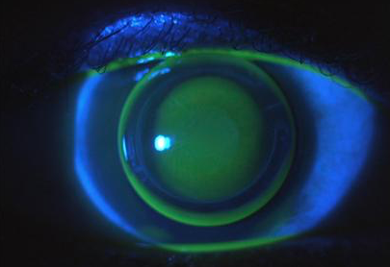
Fitting Philosophy
Lid Attachment (Korb)
  Peripheral lens contour
  Edge contour
  Edge thickness (0.08, 0.20 from apex)
  Lens mass decreased (TAP)
  BCR (FTK)
Interpalpebral
  Early fitting philosophy
  Lens to corneal alignment
  Fits between superior and inferior lids
  Utilized if lid tangent to or above superior limbus
  Not as comfortable
Modified Lid Attachment
  Something in between

Slide 52
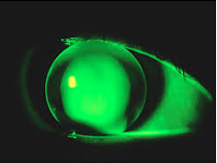
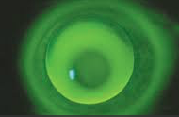
Rigid Lens Evaluation
Pooling appears green, bearing appears dark
Dumbbell pattern if corneal cylinder > 1D in flat meridian
Areas of evaluation
Apical Clearance (pooling) – lens if fit steeper than the cornea
Apical Touch (Bearing) – lens if fit flatter than the cornea

Slide 53
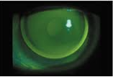
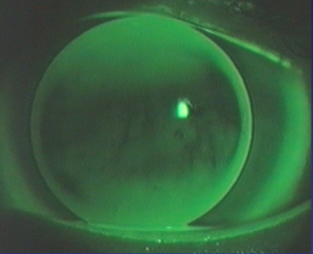
Rigid Lens Evaluation
Alignment – “Minimal Apical Clearance” (MAC)
Dumbbell has bearing in flat meridian – example shows WTR fitted on K

Slide 54
Flat Lens
Touching or bearing in the middle surrounded by clearance
Darkness indicates pressure on the cornea
Smaller darker areas mean even greater degrees of flatness (the smaller the area, the flatter the fit)
Large amounts of movement and decentration
Blinking causes a lot of movement, and the lens is dropped inferiorly if too flat
For lenses that do not lid attach, the lens is pulled up on a blink, and then dropped back down into position

Slide 55
Steep Lens
Central area of clearance
Much more comfortable because they fit tighter to the cornea
Lack of lens movement
Good initial comfort but complaints of blurry vision or redness and irritation by the end of the day
Centers well

Slide 56
Steps to correcting for Lens Types
Flat lens
  Increase the diameter first by 0.4mm
  Steepen the base curve by 0.1mm
  Don’t forget to change the power! Flatten – Add PLUS!
Steep Lens
  Decrease the diameter first by 0.4mm
  Flatten the base curve by 0.1mm
  Don’t forget to change the power! Steepen – Add MINUS!
For every half step chance in BC, change power by a quarter

Slide 57
Board Question
If a patient’s refraction (assuming 13mm vertex) is: +11.50+1.00 x 035; the keratometry readings are 44.25/45.87, and the base curve chosen is 44.75, what is the power of the final rigid gas permeable (RGP) lens?
  +12.00
  +13.50
  +14.00
  +14.50

Slide 58
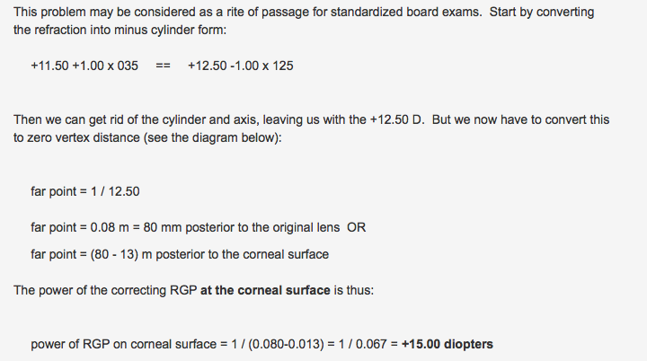
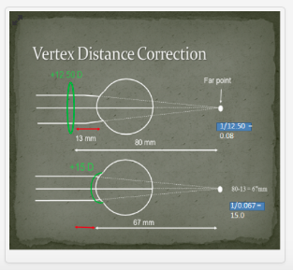
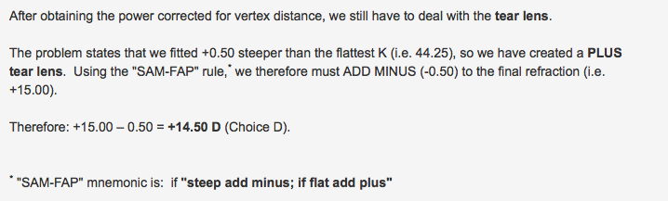

Slide 59
Board Question
A patient wears +5.00D Contact lenses. He now gets +5.00 spectacles and wears them with a vertex distance of 20mm. What is the change in magnification in using these spectacles?
  0.90
  1.00
  1.11
  1.24

Slide 60
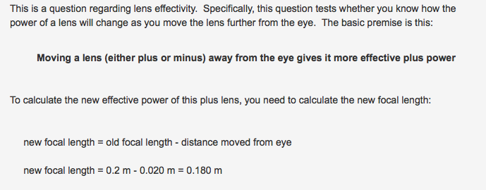

Slide 61
Board Question
What is the name of the device that measures the base curve of a contact lens?
  Keratoscope
  Radiuscope
  Retinoscope
  Basometer

Slide 62
A Radiuscope is a device that measures base curve of a contact lens
A keratoscope measures corneal curvature
A retinoscope is used in refraction
There is no such thing as a basometer

Slide 63
Rigid Gas Permeable
Corneal lens = lens that rests entirely on the cornea (<12.5mm)
Semi-scleral = lens that rests partly on cornea and partly on the sclera (12.5 to <15.0mm)
Mini-scleral – lens that rests on the sclera (15 to <18.0mm )
Full Scleral = lens that rests on the sclera >18.0mm)

Slide 64
Contact Lens Management Considerations (post keratoplasty CL fittings)
physiological limitations – how health is the eye?
Psychological attitude – patient motivation
Suture present or removed
Time after suture removal – fit CL 6-9 months afterwards
25-30% of keratoconus patients wear CL after PKP
realistic expectations
follow up care

Slide 65
Standard Rigid Lens design
  favor RGP because of Oxygen permeability and corrects irregular astigmatism
  if going with corneal RGP then use: lens with large OAD (overall diameter; traditionally lenses are <10mm but large diameters better to cover past graft;
Scleral and semi-scleral lens – go beyond limbus; definition arbitrary but most providers consider >18mm a true sclera
  More comfortable because it does not rest on cornea, does not move very much, eyelid does not bunch over lens
Hydrogel - if a patient doesn’t have much irregular astigmatism but because of anisometropia, patient is not doing well with spectacle prescription, consider hydrogel lens
Hybrid – soft skirt with rigid center
  Better comfort than rigid lens alone but better optics than soft lens
  Prevents rigid lens from falling out
Piggyback lens – soft lens underneath and rigid lens on top
  Indications: minimize abrasions, accelerate lens adaptation

Slide 66
Rigid Gas Permeable
Corneal lens = lens that rests entirely on the cornea (<12.5mm)
Semi-scleral = lens that rests partly on cornea and partly on the sclera (12.5 to <15.0mm)
Mini-scleral – lens that rests on the sclera (15 to <18.0mm )
Full Scleral = lens that rests on the sclera >18.0mm)

Slide 67
Contact Lens Management Considerations (post keratoplasty CL fittings)
physiological limitations – how health is the eye?
Psychological attitude – patient motivation
Suture present or removed
Time after suture removal – fit CL 6-9 months afterwards
25-30% of keratoconus patients wear CL after PKP
realistic expectations
follow up care

Slide 68
Standard Rigid Lens design
  favor RGP because of Oxygen permeability and corrects irregular astigmatism
  if going with corneal RGP then use: lens with large OAD (overall diameter; traditionally lenses are <10mm but large diameters better to cover past graft;
Scleral and semi-scleral lens – go beyond limbus; definition arbitrary but most providers consider >18mm a true sclera
  More comfortable because it does not rest on cornea, does not move very much, eyelid does not bunch over lens
Hydrogel - if a patient doesn’t have much irregular astigmatism but because of anisometropia, patient is not doing well with spectacle prescription, consider hydrogel lens
Hybrid – soft skirt with rigid center
  Better comfort than rigid lens alone but better optics than soft lens
  Prevents rigid lens from falling out
Piggyback lens – soft lens underneath and rigid lens on top
  Indications: minimize abrasions, accelerate lens adaptation

