Slide 1
Optics of Ophthalmic Instruments
Haleh Ebrahimi, OD
Clinical Assistant Professor
University of Pittsburgh Medical Center

Slide 2
Most used instruments
Binocular Indirect Ophthalmoscope
Retinoscope
Lensometer
Keratometer

Slide 3
Binocular Indirect Opthalmoscope

Slide 4
Principles of a Slide Projector
An intense source of light illuminates a transparent slide from behind and makes that slide a Luminous object on its own
That luminous object emits light which is picked up by the projector lens

Slide 5
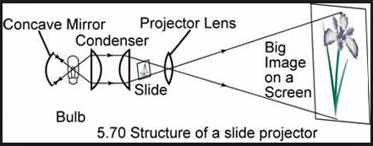
Principles of a Slide Projector
The lens is situated so that the object is just beyond its primary focal plane
The final image can then be projected onto a screen

Slide 6
Binocular Indirect Ophthalmoscope
With the indirect, you make the fundus a luminous object (the slide of the last example)
The eye acts like a miniature opaque projector and projects that object out into space
This is done by shining an intense source of light through the pupil – the fundus image is then projected out

Slide 7
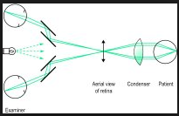
An emmetropic eye would project that image to infinity
We use a 20D hand held condensing lens to create the image in its secondary focal plane
This image is called an aerial image and is inverted when compared to the orientation of the fundus itself

Slide 8
Optics of BIO
That aerial image has thickness representing any thickness present in the fundus itself
Any excavation of the nerve head or elevated of a choroidal lesion will be manifested in the “depth” of the image
The longer the focal length of the condensing lens, the farther from the lens the image will be → increased lateral magnification

Slide 9
Question
Which of the following lenses provided the largest field of view?
15 D lens
20 D lens
30 D lens
Field of view is the same in all the lenses

Slide 10
Question
Which of the following lenses provided the largest field of view?
15 D lens
20 D lens
30 D lens
Field of view is the same in all the lenses
Field of view = dioptric power x 2

Slide 11
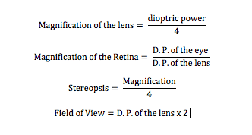
Binocular Indirect Ophthalmoscope
Axial images dimensions are especially THICKENED by the LOWER powered (longer focal length) condensing lens

Slide 12
Binocular Indirect Ophthalmoscope
30 Diopter Lens (highest magnification)
Yields LEAST magnification of retina 60/30=2x
Stereopsis is half that of the normal 2/4=1/2
Largest field of view 30x2= 60 degrees
15 Diopter Lens
Magnification of retina 60/15= 4x
Stereopsis 4/4=1 → FULL STEREOPSIS = thickened image
Field of view 15x2= 30 degrees
20 D lens is most used since it provides adequate field of view, stereopsis and magnification

Slide 13
Advantages of Binocular Indirect Ophthalmoscopy
Stereoscopic visualization
Increased field of view vs. direct ophthalmoscopy (25° vs 8°)

Slide 14
Light Reflexes
3 bright reflexes (from the cornea, pupil and crystalline lens) when trying to visualize the fundus
The condenser is a biconvex lens, the anterior surface forms a virtual reflected image of the illuminating headlamp, and the posterior surface, being concave to the illuminating source, forms a real image
These images move in opposite directions if the lens is tilted
The higher the D.P. Of the condensing lens, the more will be tilting necessary to move reflexes away from the center of view

Slide 15
Board Question

Slide 17
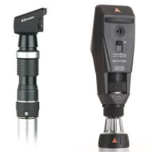
Retinoscope
To determine the refractive error of an eye objectively
It is a small projector which emits a spot or streak like image of the lamp filament itself
This projector is aimed at the patient’s eye

Slide 18
Retinoscope
The retinoscopist can project that image onto a wall any distance away and focus it sharply, from infinity to any place behind or in front of the patient’s eye
2 principals:
Plano-mirror Effect
Concave-mirror Effect

Slide 19
Plano-Mirror Effect
Effective light source lies behind the plane of the mirror (most common used)
The rays of light from the source goes parallel or slightly diverging
Does not cross between the source and the patient’s eye
With movement – hyperopia
Against movement – myopia
Direction of motion of the light source on the retina will always be in the same direction as the motion of the retinoscope light as it crosses along the patient’s face

Slide 21
Concave-Mirror Effect
Keep the effective source in front of the plane of the mirror
rays emitted from source are more converging
cross at a certain distance between patient and the source
With movement – Myopia
Against Movement – Hyperopia
Not used as often
Direction of motion of the light source on the retina will always be in the opposite direction as the motion of the retinoscope streak

Slide 23
Retinoscopy
The closer the observer’s eye the patient’s luminous retinal image is located, the larger and brighter will be the illuminated shadow and the quicker it will move
Plus lens used to counter any observed “with” motion
Minus lens for “against” motion
Goal is to “Neutralize” the observed motion with the lens

Slide 24
Working Distance
To find the “corrective” lens to help the patient see optical infinity, we must image the retina not at the retinoscope but further back behind the observer, at infinity
The lens has to be a power of 1/d
Ex. 50 cm working distance
1/0.5=2
Means subtract 2D from the lens you found to neutralize the reflex
For an astigmatic eye, each meridian must be neutralized separately

Slide 25
Board Question
A. +1.00 + 2.75 x 135
B. +1.00 + 2.75 x 045
C. +3.00 + 2.75 x 135
D. +3.00 +2.75 x 045

Slide 27
The Lensometer

Slide 28
Lensometer
To quickly determine the power, cylinder and axis of an “unknown” lens
Can measure the amount and direction of any prism that may be incorporated or induced by the lens
Most clinically important information about any corrective lens is the distance between its back surface and its secondary focal point = back focal length

Slide 29
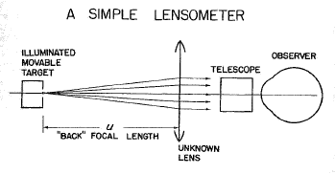
A Simple Lensometer
The vertex power (effective power) = the reciprocal of the back focal length

Slide 30
A Simple Lensometer
A grid like, luminous target is moved back and forth until light rays leaving the lens are parallel
(as detected by a small eyepiece telescope which is focused for infinity so that only the parallel light bundles will appear to be clear)
The target must then be located at F’ of the lens
Its distance u is simply measured and converted to diopters
This method is impractical because the instrument would have to be too long

Slide 31
A Lensometer
Uses Badal’s Principle to shorten the length needed to measure the power of an unknown lens
The fixed field lens is placed so that its focal point exactly coincides with the posterior vertex of the unknown lens
The observer moves the illuminated target back and forth in relation to the fixed field lens until the reticle target appears sharply in focus through the eyepiece telescope

Slide 33
The Lensometer
With the focal point of the field lens situated exactly at the posterior vertex of the “unknown” lens, the proper optical condition is set up so…
The distance u is DIRECTLY proportional to the power of the unknown lens
The scale will not shrink as higher power lenses are tested

Slide 34
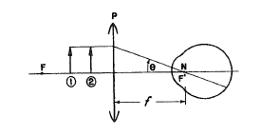
The Badal Principle
Knapp’s Law applied to Lensometers

Slide 35
The Badal Principal
Place any plus lens in front of the eye so that the lens’ F’ coincides with the eye’s nodal point
An object is put in front of that lens, but closer than its primary focal point F

Slide 36
The Badal Principal
The object tip will emit one ray which is parallel to the axis
After refraction, that ray will pass through F’
Since F’ was made to coincide with the nodal point of the eye, the ray will continue undeviated

Slide 37
Determining an Add with a Lensometer
To obtain the distance power of any lens, you must use the Lensometer to measure the back focal length
The front focal length is a better indicator of the ability of a “thick lens” to deal with near objects
If the add on the aphakic lens is read with the lens in the ‘normal’ instead of ‘reversed’ position, the indicated power will be too high in plus compared to its actual effectivity

Slide 38
Board Question
A light source falls on an unknown lens. A line is formed at 45° at 20 cm. When the screen is moved to 33cm, the line is at 135°. At what distance from the lens is a circle seen on the screen?
A. 20cm
B. 22.5 cm
C. 25 cm
D. 26.5 cm

Slide 40
Board Question
A light source falls on an unknown lens. . A line is formed at 45° at 20 cm. When the screen is moved to 33cm, the line is at 135°. What is the prescription of the lens?
A. +3.00 +2.00 x 045
B. +4.00 Sphere
C. +3.00 + 5.00 x 045
D. +5.00 + 3.00 x 135

Slide 42
Keratometer

Slide 43
The Keratometer
To measure the corneal curvature
Measures the anterior 3mm surface of the cornea
Used mainly for contact lens fitting
Keratometer measures the size of the reflected image to give the radius of curvature of that anterior corneal surface

Slide 44
Information provided by a Keratometer
The radii of curvature of the cornea
The directions of the principal meridians of the eye, determining whether the astigmatism is with-the-rule or against-the-rule
a key factor in contact lens fitting
The degree of corneal astigmatism
The presence of any corneal distortion (keratoconus, pterygium, corneal scarring)

Slide 45
Optical Principles
Cornea is a convex refracting surface
To find the refracting power of the cornea, we need to reflect an object of a known size at a known distance off the corneal surface.
Then determine the size of the reflecting image with measuring telescope and calculate the refractive power of the cornea based on the refractive index of n=1.3375

Slide 48
Keratometer
The radius of curvature of of a mirror will determine the size of the image it produces from a given sized object
If we illuminate an object of known size, place it a known distance from the cornea, are are able to measure the size of the reflected image, we can deduce the radius of curvature
The cornea is considered a high powered mirror (-250 D), an object does not have to be too far away to be effectively at the cornea’s optical infinity

Slide 51
Surface Power Formula
The keratometer usually shows the curvature in diopters of power or in millimeters and diopters
If a millimeter scale is not given, it can be found from tables or by using the surface power formula using the refractive index 1.3375
Surface Power Formula:
D = the dioptric power of the Cornea
n = the refractive index of the keratometer used (1.3375)
R = the radius of curvature of the cornea in meters
Notes:
https://www.slideshare.net/hmirzaeee/keratometry-31466440

Slide 53
Notes:
https://www.slideshare.net/KaranBhatia25/keratometry-55540991

Slide 55
Question
A standard manual keratometer measures central corneal power at what approximate diameter?
1.65
2.5
3.2
5.0

