Slide 1
IOL’s/ Refractive/ Surgical Considerations
Haleh Ebrahimi, OD
Clinical Assistant Professor
University of Pittsburgh Medical Center

Slide 2
Early Intraocular Lens Design
iris-clip – early design with increased complications (CME and UGH syndrome)
rigid anterior chamber lenses - early design with increased complications (CME and UGH syndrome)
C-loop haptic by Dr. Robert M. Sinskey in 1981 (Figure 4), a modification of the Shearing J-loop lens invented by Stephen P. Shearing in 1977
Notes:
http://www.iolsafety.com/dmdocuments/understanding-intraocular-lenses-the-basics-of-design-and-material.pdf

Slide 3
Intraocular Lens Design
foldable IOLs by Dr. Edward Epstein in South Africa in the 1960s and 1970s and by Dr. Thomas Mazzocco in the United States in 1984 allowed for further improvement in surgical technique by helping to give to the rise to small- incision surgery in the late 1980s.
continuous capsulotomy fostered more reliable in-the-bag IOL implantation that allowed increased IOL stability and improved centration
The most common materials used today are foldable silicone and acrylic, as they can be implanted through a small incision.
  Polymethyl methacrylate (PMMA), less commonly used, is a rigid material suitable for rigid 1- and 3-piece IOL designs or for haptic materials
Notes:
http://www.iolsafety.com/dmdocuments/understanding-intraocular-lenses-the-basics-of-design-and-material.pdf

Slide 4
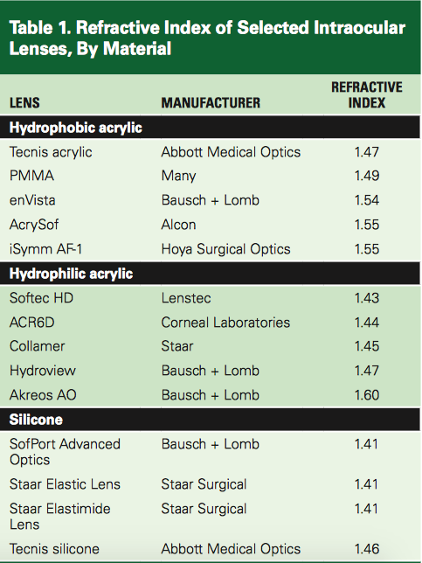
Hydrophobic materials contain less than 2% water,
Hydrophilic materials contain18%–38% water
Notes:
http://www.iolsafety.com/dmdocuments/understanding-intraocular-lenses-the-basics-of-design-and-material.pdf

Slide 5
Optical considerations for intraocular lenses
Intraocular lens power calculation
  Theoretic formulas are derived from optical principles and use assumed dimensions for certain parts of the eye (eg. Binkhorst, Colenbrander)
  Empiric formula are derived by regression analysis from clinical results. A mathematical relationship between
    Corneal curvature
    Axial length
    Intraocular lens power can be derived (eg. SRK)

Slide 6
SRK (Saunders, Retzlaff, and Kraff) formula
P=A-2.5L-0.9K
P is the power for emmetropia
A is a lens constant
L is the axial length in millimeters
K is the average corneal curvature in diopters
The lens constant (A) is an unique constant related to lens type and manufacturer

Slide 7
Question 1
Using the SRK formula, how much of an error in intraocular lens power would result from a 0.5D mistake during keratometry?
  0.5 x 0.9 = 0.45 D, or about half a diopter
From a 0.5mm mistake during axial length measurement?
  0.5 x 2.5 = 1.25 D
It should be obvious that small errors in axial length can translate into large errors in calculated lens power.

Slide 8
Question 2
A patient presents with average keratometry readings of 43 D and an axial length of 19mm. Which IOL formula do you recommend?
  Not the SRK or Binkenhorst (theoretical formulas overestimate while SRK underestimates it)
  SRK II, SRK/T, and Holladay – more accurate for very long or very short eyes
  SRK II not as good with Very long eyes but simple enough to calculate on hand
  It is the same as the SRK formula, but the A constant is modified for long or short eyes

Slide 9
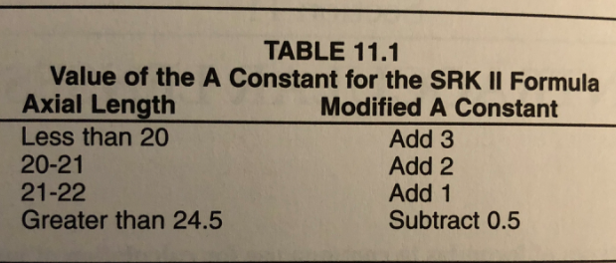
SRK II Formula

Slide 10
Question 2
A patient presents with average keratometry readings of 43 D and an axial length of 19mm. Which IOL formula do you recommend?
  If the SRK formula had recommended an IOL power of +32 D, the SRK II formula tells you to use +32 +3 = +35D
SRK/T (“T” stand for “theoretical”) and Holladay are complicated theoretical formulas refined by empiric observations.
Many A scan units contain computer software that calculates recommended IOL power based on one of the newer formulas

Slide 11
Piggyback and Supplemental Intraocular Lenses
Piggyback technique – implantation of a secondary IOL
  classically consists on the implantation of both the primary and secondary IOL in the capsular bag
  an Add-On IOL consists on the implantation of the primary IOL in the capsular bag and the secondary IOL in the ciliary sulcus
  main indications for secondary piggyback IOL implantation are:
    postoperative ametropia
    pseudophakic presbyopia
  available as monofocal, multifocal, toric and multifocal toric models
Supplemental intraocular lenses (IOLs) have been developed to replace IOLs designed for in-the-bag placement being used as "piggy-back" IOLs in the sulcus due to unacceptable complications

Slide 12
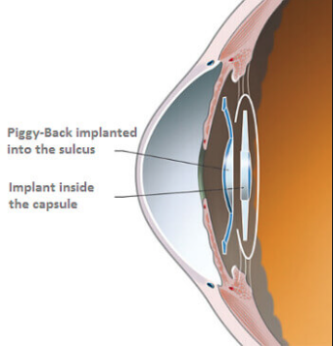

Slide 13
Piggyback and Supplemental Intraocular Lenses
In patients with post IOL refractive surprise or in those with large dioptric requirement, a piggy back IOL in sulcus can be placed along with the primary implant. This method does not require knowledge of the power of the primary implant or of the axial length. Minor adjustments are needed, which can be achieved using these formulas:
Myopic correction: P = 1.0 x Error
Hyperopic correction: P = 1.5 x Error
where
P = the needed power in the piggyback lens
Error = the residual refractive error that needs to be corrected

Slide 14
Question 3
You are examining an unhappy, post-operative cataract surgery patient who desired to be set at Plano in the operative eye. However, at his 1 month post-op appointment, his manifest refraction is -2.50 sphere in the operative eye. Which of the following errors would most likely cause this myopic surprise?
  Mistakenly inserting an intraocular lens (IOL) whose dioptric power was significantly lower than the originally planned IOL
  Neglecting to use a special formula is this patient had undergone previous myopic LASIK
  Forgetting to subtract from the “in-the-bag” power when the lens was actually inserted into the ciliary sulcus
  Use of contact A-scan for axial length measurement

Slide 15
Question 3
You are examining an unhappy, post-operative cataract surgery patient who desired to be set at Plano in the operative eye. However, at his 1 month post-op appointment, his manifest refraction is -2.50 sphere in the operative eye. Which of the following errors would most likely cause this myopic surprise?
  Mistakenly inserting an intraocular lens (IOL) whose dioptric power was significantly lower than the originally planned IOL
  Neglecting to use a special formula is this patient had undergone previous myopic LASIK
  Forgetting to subtract from the “in-the-bag” power when the lens was actually inserted into the ciliary sulcus
  Use of contact A-scan for axial length measurement

Slide 16
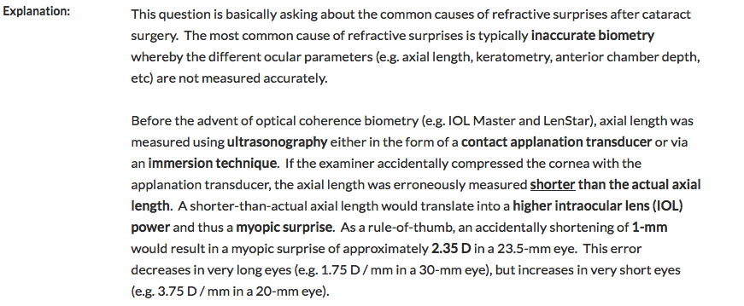

Slide 17
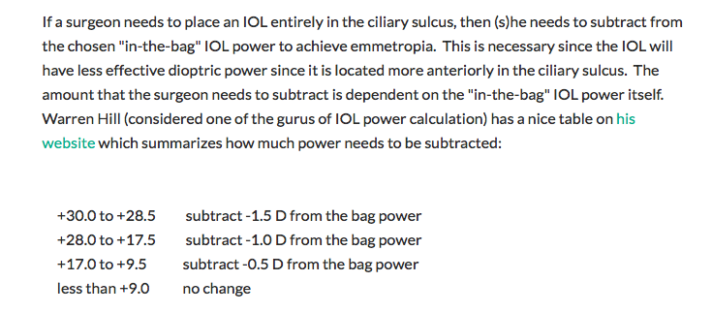

Slide 18
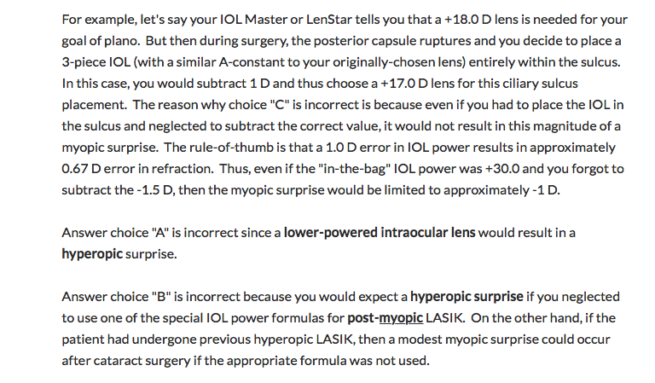

Slide 19
Intraocular Lens Power in Corneal Transplant Eyes
It is extremely difficult to accurately predict corneal power in transplant patients.
If a triple procedure is planned it is suggested that K readings of other eye be used.
An alternative option is to use the average k readings from a series of previous transplants.
If there is a corneal scar, but no graft is planned, other eye readings can be used or even the power calculated using AL (axial length) and refractive error of affected eye
Notes:
Geggel HS.lntraocular lens implantation after penetrating keratoplasty. Improved unaided visual acuity, astigmatism, and safety in patients with combined corneal disease and cataract. Ophthalmology. t990;97(11): t460- 1467.
Hoffer KJ. Triple procedure for intraocular lens exchange. Arch Ophtha/rnol. 1987; 105(5): 609- 610.

Slide 20
Intraocular Lens Power in Corneal Transplant Eyes
Paper: Intraocular lens calculation in a patient with previous penetrating keratoplasty and LASIK. Adrean SD¹, Reilly C, Mannis MJ cornea. 2005 Jul;24(5):629-31.
Using pre-LASIK keratometry values, the IOL power is calculated using the SRK/T formula.
This IOL power is then corrected by adding the change in spherical equivalent achieved by the refractive surgery, corrected to the corneal plane from the spectacle plane by dividing the change in spherical equivalent by 0.7
17 eyes of 12 patients have undergone cataract extraction with IOL calculated using this method,
  64% within 0.5 D of intended spherical equivalent,
  94% within 1.0 D, and
  100% within 1.5 D of intended spherical equivalent
Notes:
cornea. 2005 Jul;24(5):629-31.
Intraocular lens calculation in a patient with previous penetrating keratoplasty and LASIK.
Adrean SD¹, Reilly C, Mannis MJ

Slide 21
Intraocular Lens Power in Corneal Transplant Eyes
SRK/T using
  A-constant of 118.4;
  Ks: 42.50/50.0 (Pre-LASIK Ks) and
  axial length of 24.85 mm yields IOL for emmetropia of 16.77 D.
  3.25 D (change in SE pre- versus post LASIK)/0.7 = 4.64D
    SE at the spectacle plane pre-LASIK was -5.25 and post-LASIK was -2.00 for a change of 3.25 D.
  16.77D + 4.64D = 21.41D the corrected IOL power: 21.5 D IOL chosen
using the nomogram described by Feiz et al
Notes:
Feiz V, Mannis MJ, Garcia-Ferrer F, et al. Intraocular lens power calculation after laser in situ keratomileusis for myopia and hyperopia: a standardized approach. Cornea. 2001;20:792-797

Slide 22
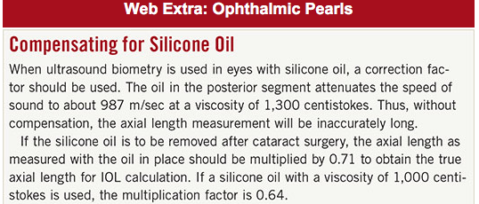
Post-Vitrectomy IOL selection
Notes:
https://www.aao.org/eyenet/article/phacoemulsification-after-pars-plana-vitrectomy-pe#web_extra

Slide 23
Pediatric Eyes
The problems in pediatric age, especially the very young; includes the increased errors in AL measurement, which compounds the final IOL power errors due to shorter AL.
AL and K value must be measured under general anesthesia.
Goal of IOL power chosen
  prevent amblyopia
  ideally also give emetropia in adult age.
Currently all infants above two months are advised IOL implantation.
The development of the eye necessitates initial under-correction to avoid later myopic shift.
The growth of the anterior segment is usually completed at around two years hence the IOL aimed for is about 80% of the calculated amount of power.

Slide 24
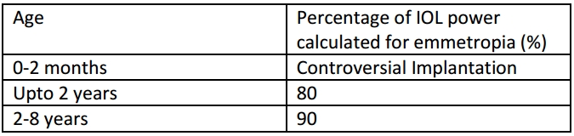
Pediatric Eyes
Notes:
http://eyewiki.aao.org/Biometry_for_Intra-Ocular_Lens_(IOL)_power_calculation#In_Corneal_Transplants

Slide 25
Image Magnification
The new Oculentis high magnification IOL has been designed to magnify images 2.5 times.
The result is that images are magnified 2.5 times to improve the vision and lifestyle for patients with Macular Degeneration, cataracts and poor vision.
Concept: Low vision aids such as magnifying spectacles and magnifying aids can assist patients with poor vision.
Notes:
https://www.personaleyes.com.au/high-mag-iol/

Slide 26
Intraocular Lens-Related Vision Disturbances
Blurred vision
  Causes: ametropia, dry eye, PCO, unexplained etiology
Photic phenomena (unwanted light images that may occur after surgery due to optical media imperfections )
  Causes: IOL decentration, retained lens fragment, PCO, dry-eye syndrome, and unexplained etiology

Slide 27
Multifocal Intraocular Lenses
FDA approved Multifocal IOL:
  Technis Symfony IOL (Abbot Medical Optics)
  AcrySof IQ ReSTOR (Alcon) – a toric, multifocal IOL
These IOLs provide both distance and near focus at the same time. The lens has different zones set at different powers. It is designed so that your brain learns to select the right focus automatically.
Notes:
http://www.allaboutvision.com/conditions/iols.htm

Slide 28
Other Premium IOLs
Toric IOL can correct astigmatism because they have different powers in different meridians of the lens – same concept as toric CL
They also have alignment markings on the peripheral part of the lens that enable the surgeon to adjust the orientation of the IOL inside the eye for optimal astigmatism correction.
FDA Approved Toric IOL:
  Tecnis Toric (Abbott Medical Optics)
  AcrySof IQ Toric (Alcon)
  Trulign Toric (Bausch + Lomb).

Slide 29
Other Premium IOLs
Accommodating IOLS expand the range of clear vision with both an aspheric design and flexible "haptics" — the supporting legs that hold the IOL in place inside the eye.
These flexible legs allow the accommodating IOL to move forward slightly when you look at near objects, which increases the focusing power of the eye enough to provide better near vision than a conventional monofocal lens.
FDA Approved Accommodating IOLs
  Crystalens AO (Bausch + Lomb)
  Trulign Toric IOL (Bausch + Lomb)
    The Trulign Toric lens corrects astigmatism as well as presbyopia

Slide 30
Question 4
In general, which of the following post refractive surgery patients would tolerate the insertion of a multifocal intraocular lens (MFIOL) the best?
  Post myopic LASIK/PRK patient
  Post hyperopic LASIK/PRK patient
  Post-RK (radial keratotomy) patient
  All of these patients general have the same acceptance of multiocal IOLs

Slide 31
Question 4
In general, which of the following post refractive surgery patients would tolerate the insertion of a multifocal intraocular lens (MFIOL) the best?
  Post myopic LASIK/PRK patient
  Post hyperopic LASIK/PRK patient
  Post-RK (radial keratotomy) patient
  All of these patients general have the same acceptance of multiocal IOLs

Slide 32
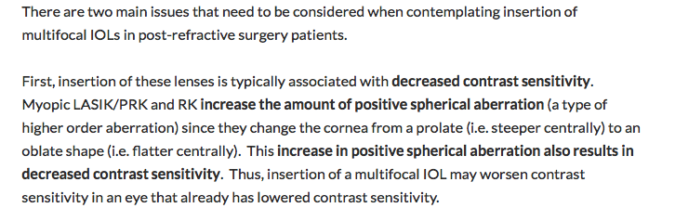

Slide 33
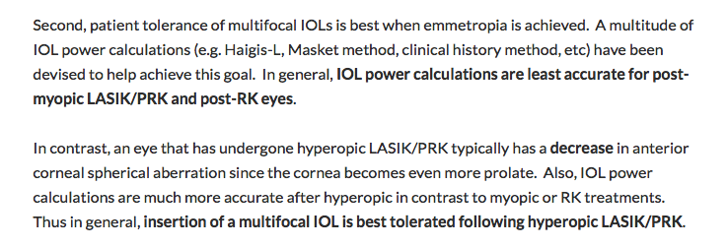

Slide 34
Question 5
You have just broken the posterior capsule and completely aspirated the bag. You attending would like you to insert an anterior chamber intraocular lens (ACIOL) into the eye. The technician asks what length you would like to use. You say, “Does it matter?” Your attending glares at you and says, “Yes”. You are told that the horizontal white-to-white distance is 12.5 mm and the vertical is 11.5 mm. Which of the following ACIOL lengths is best for this patient?
  12.5mm
  13 mm
  13.5mm
  none will fit the patient

Slide 35
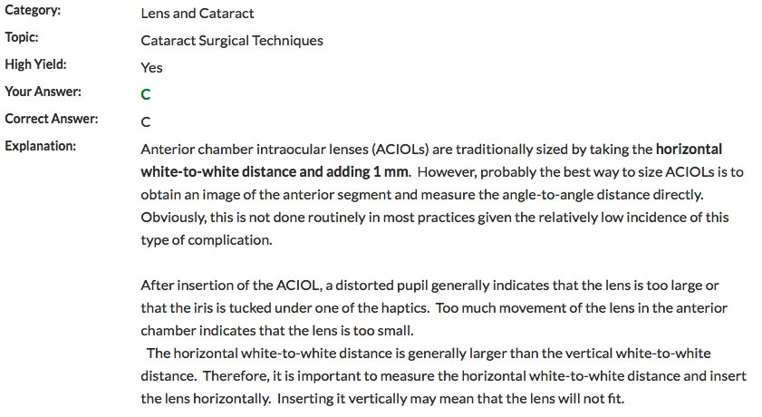

Slide 36
Question 6
A patient presents for preoperative evaluation for cataract surgery. The refraction in the cataractous eye is -9.50 sphere. She has been wearing a contact lens over that eye to correct the anisometropia. Keratometry readings in the eye are 43.00/42.50. What is a potential source of error in the IOP calculations in this case?
  Axial Length
  Keratometry
  Refraction
  Power

Slide 37
Question 6
A patient presents for preoperative evaluation for cataract surgery. The refraction in the cataractous eye is -9.50 sphere. She has been wearing a contact lens over that eye to correct the anisometropia. Keratometry readings in the eye are 43.00/42.50. What is a potential source of error in the IOP calculations in this case?
  Axial Length
  Keratometry
  Refraction
  Power

Slide 38
The contact lens must be removed a minimum of 2 hours before Keratometry.
Errors caused by molding of the cornea can amount to 1 D.
Some clinicians recommend remocing the contact lens 2 weeks before keratometry, while others say 2 hours is enough

Slide 39
Question 7
A 23 year old patient calls your office and states that she wants to be scheduled as soon as possible for LASIK surgery. She states that she wears soft toric contact lens. You tell the patient to stop wearing her contacts lenses and that the earliest she can have the surgery is:
  1 Day
  3 Days
  10 Days
  14 days

Slide 40
Question 7
A 23 year old patient calls your office and states that she wants to be scheduled as soon as possible for LASIK surgery. She states that she wears soft toric contact lens. You tell the patient to stop wearing her contacts lenses and that the earliest she can have the surgery is:
  1 Day
  3 Days
  10 Days
  14 days

Slide 41
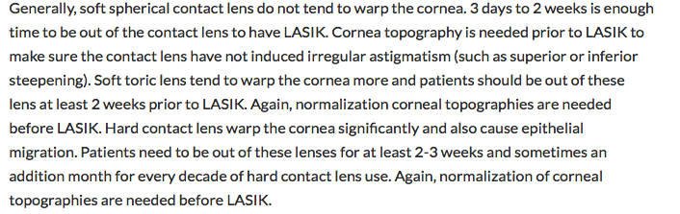

Slide 42
Question 8
You are performing cataract surgery on Mr. Matt Tuculous, the husband of a successful Malpractice attorney. After flawless phacoemulsification in record time, you insert the first haptic of a +19.00D lens and prepare to slip the optic under the iris. To your horror, you realize your new technician calculated the power for 1 D hyperopia, not the 1 D of myopia that you requested. You remove the lens from the eye of your patient. Your IOL power calculator is 30 miles away at your satellite office, which is closed. What power lens do you insert in its place?

Slide 43
The general rule of thumb for normally sized eyes with a implant power of about +18.00 D is to change the calculated IOL power by 1.25 to 1.50 D for each desired ametropia.
Therefore, if the calculated lens power for one diopter of hyperopia was +19.00, you should select a +21.50 or +22.00D lens.

Slide 44
Question 9
Mr. Ticulous returns for his 23rd postoperative refraction, 6 months following his first cataract extraction. He complains of decreased visual acuity in his pseudophakic eye. Best corrected visual acuity has dropped from 20/25 to 20/40. He also notes glare. How do you proceed?

Slide 45
Recheck the refraction, and check pinhole acuity with best correction in place
Look at the IOL position before dilating the pupil
  Are there possible sources of glare visible? (IOL defects, a centration hole, or an IOL edge)
Is there a PCO? Corneal decompensation?
Any anterior segment opacities to acuity
Evaluate the retinoscopic reflex to identift any irregularities or opacities in the media
Dilate the pupil and look again at the IOL and posterior capsule
If the front of the eye cant explain the decrease in acuity, direct your attention to the retina and beyond.

Slide 46
Optical Considerations in Keratorefractive Surgery
Corneal Shape:
  keratorefractive surgery for myopia reduces spherical refractive error and regular astigmatism, but it increases spherical aberration and irregular astigmatism
  keratorefractive surgery moves the location of the best focus closer to the retina but makes the focus less stigmatic. Such irregular astigmatism is what underlies many visual complaints after refractive surgery.

Slide 47
Optical Considerations in Keratorefractive Surgery
Ablative procedures, incisional procedures, and intracorneal rings change the natural shape of the cornea to reduce refractive error.
Keratometry readings before keratorefractive surgery typically range from 38.0 D to 48.0 D
avoid changes that may result in excessively flat (<33.0 D) or excessively steep (>50.0 D) corneal powers
A 0.8 D change in keratometry value (K) corresponds to approximately a 1.00 D change of refraction

Slide 48
Optical Considerations in Keratorefractive Surgery
The anterior corneal surface produces most of the eye’s refractive power.
In the Gullstrand model eye, the anterior corneal surface has a power of +48.8 D and the posterior corneal surface has a power of –5.8 D, so the overall corneal refractive power is +43.0 D
standard corneal topography instruments and keratometers do not assess the posterior corneal surface – therefore are said to do not measure corneal power precisely
  They estimate total corneal power by assuming a constant relationship between the anterior and posterior corneal surfaces
  This constancy is disrupted by keratorefractive surgery
Notes:
https://entokey.com/optical-considerations-in-keratorefractive-surgery/

Slide 49
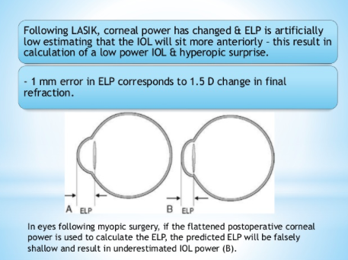
Notes:
https://www.slideshare.net/pushprajsingh7/post-lasik-iol-surgery

Slide 50
Optical Considerations in Keratorefractive Surgery
For example, after myopic excimer surgery, the anterior corneal curvature is flattened.
posterior corneal surface remains unchanged or slightly steeper than the preoperative posterior corneal curvature, increasing its negative power.
  due to reduction in corneal pachymetry and weakening of the cornea
The decrease in positive anterior corneal power and the (minimal) increase in negative posterior corneal power cause an increase in the relative contribution to the overall corneal refractive power of the posterior surface.
Notes:
https://entokey.com/optical-considerations-in-keratorefractive-surgery/

Slide 51
Optical Considerations in Keratorefractive Surgery
An ideal LASIK ablation or PRK removes:
  a convex positive meniscus in corrections of myopia
  a concave positive meniscus in simple corrections of hyperopia
A toric positive meniscus is removed in corrections of astigmatism.
  In toric corrections, the specific shape of the ablation depends on the spherical component of the refractive error.
Notes:
https://entokey.com/optical-considerations-in-keratorefractive-surgery/

Slide 52
Question 10
What is the Optic Power of the anterior corneal surface?
42D
44D
46D
48D

Slide 53
Question 10
What is the Optic Power of the anterior corneal surface?
42D
44D
46D
48D
The anterior corneal surface has a dioptric power of 48D.
The posterior corneal surface has a dioptric power of -5.8D
Therefore the average Dioptric power is around 43 D

Slide 54
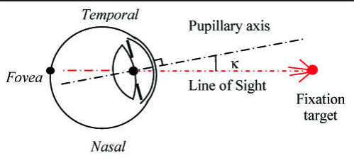
Angle
Kappa
the pupillary axis is the imaginary line that is perpendicular to the corneal surface and passes through the midpoint of the entrance pupil.
The visual axis is the imaginary line that connects the point of fixation to the fovea.
The angle kappa (κ) is defined as the angle between the pupillary axis and the visual axis
Notes:
https://entokey.com/optical-considerations-in-keratorefractive-surgery/

Slide 55
Angle Kappa
A large angle kappa results from a significant difference between the pupillary axis and the central corneal apex.
If the angle kappa is large, centering an excimer ablation over the geometric center of the cornea will effectively result in a decentered ablation.
  problematic in a hyperopic correction, in which a large angle kappa can result in a refractively significant “second corneal apex,” causing monocular diplopia and decreased quality of vision.
A large angle kappa must be identified before surgery to reduce the likelihood of a poor visual outcome.
Ablation should be centered on the corneal vertex as opposed to the entrance pupil center to avoid decentered ablation
Notes:
https://entokey.com/optical-considerations-in-keratorefractive-surgery/

Slide 56
Irregular Astigmatism
Astigmatism where the principle meridians are not 90 degrees apart and associated with loss of vision
Represents one of the most serious and frequent complications of corneal refractive surgery
Occurs when the orientation of the principal meridians changes from one point to another across the pupil, or when the amount of astigmatism changes from one point to another
Notes:
http://www.wangcataractlasik.com/forms/drWang_Irregular_astigmatism.pdf

Slide 57
Irregular Astigmatism
Further distinction includes regularly or irregularly irregular astigmatism
  Relates to the presence of pattern recognition on computerized topography
  Irregularly irregular astigmatism is rough or uneven, and shows no recognizable pattern on topography
Notes:
http://www.wangcataractlasik.com/forms/drWang_Irregular_astigmatism.pdf

Slide 58
Clinical causes of irregular astigmatism
Irregular but stable cornea (eg. Irregular scar surface)
  Cornea is irregular because of LOCAL geography
Irregular but unstable cornea (biochemical decompensation) = GLOBAL
Clinical causes:
  CL warpage/overwear Limbal/corneal dystrophies
  FFKC/Keratoconus/Pellucid Chalazion
  Pterygium Dry eye
  Trauma others
  Extreme GPC
  Keratorefractive surgery (LASIK, PRK, CK, ectasia)
Notes:
http://www.wangcataractlasik.com/forms/drWang_Irregular_astigmatism.pdf

Slide 59
Question 11
Which of the following is true concerning higher order aberations after refractive surgery?
  They are reduced only with custom wave front guided LASIK
  They are reduced
  They are increased
  They are reduced only with wave front optimized LASIK

Slide 60
Question 11
Which of the following is true concerning higher order aberations after refractive surgery?
  They are reduced only with custom wave front guided LASIK
  They are reduced
  They are increased
  They are reduced only with wave front optimized LASIK

Slide 61
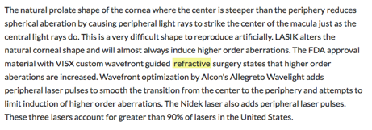

Slide 62
Question 12
Which of the following corneal refractive procedures involves using a blunt microkeratome to remove only the epithelium and then ablating the stromal bed?
  LASIK
  LASEK
  Epi-LASIK
  PRK

Slide 63
Question 12
Which of the following corneal refractive procedures involves using a blunt microkeratome to remove only the epithelium and then ablating the stromal bed?
  LASIK
  LASEK
  Epi-LASIK
  PRK

Slide 64
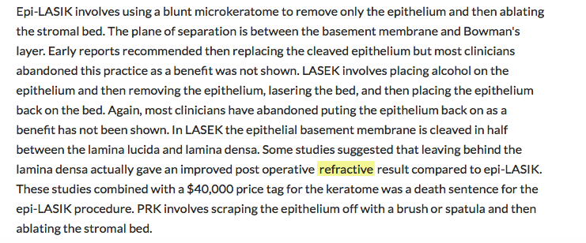

Slide 65
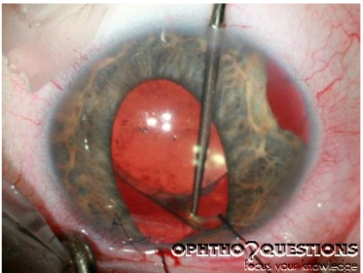
Question 13
You are examining a 52-year-old patient who underwent cataract surgery at another clinic one year ago. He states that he has experienced problems ever since the procedure with elevated intraocular pressures and recurrent hyphemas. You decide to investigate further and during surgery, note the findings seen in the image above. What is the patient’s problem? (note: please ignore the iridodialysis for this question)
  An ACIOL placed in the posterior chamber
  A single piece IOL placed in the anterior chamber
  A three piece lens placed in the capsular bag
  A single piece posterior chamber lens with at least one haptic in the sulcus

Slide 66
Question 13
You are examining a 52-year-old patient who underwent cataract surgery at another clinic one year ago. He states that he has experienced problems ever since the procedure with elevated intraocular pressures and recurrent hyphemas. You decide to investigate further and during surgery, note the findings seen in the image adove. What is the patient’s problem? (note: please ignore the iridodialysis for this question)
  An ACIOL placed in the posterior chamber
  A single piece IOL placed in the anterior chamber
  A three piece lens placed in the capsular bag
  A single piece posterior chamber lens with at least one haptic in the sulcus

Slide 67
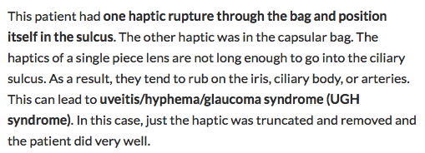

Slide 68
Question 14
What is the disadvantage of a plano/convex IOL design (implanted with the convex surface closer to the cornea)?
  It has more spherical aberration
  A plano/convex IOL has more spherical aberration than a biconvex design
  A biconvex IOL with a rear surface power that is stronger than the front surface power causes the least spherical aberration.

Slide 69
Question 15
You complete the above surgery after requesting and deftly inserting a +21.50D intraocular lens in your patient’s eye. While dictating the operative note, you realize that the circulating nurse handed you a +27.50 D lens. You quickly calculate that this mistake will leave the patient quite anisometropic. Will the patient be hyperopic or myopic in the operated eye? What do you tell the patient and his wife?
  Myopic
  Consider the ethical considerations of mistakes and poor outcomes
  What would you tell a patient after you made a mistake?

