Slide 1

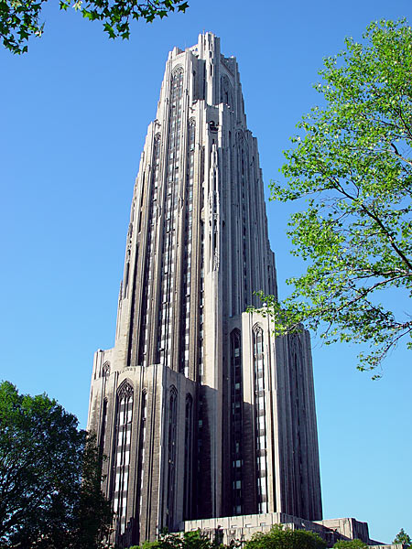
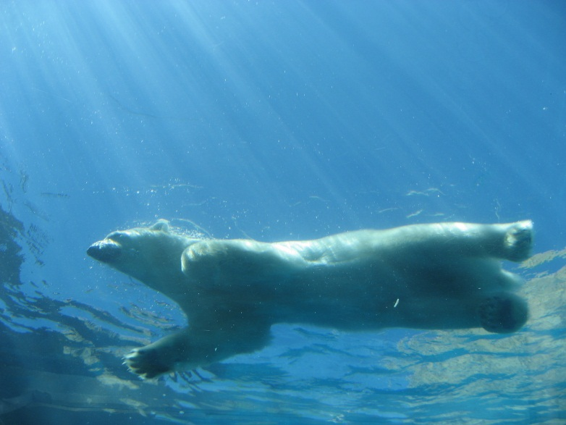
Regulations

Slide 2
PHS and USDA
PHS Policy on Humane Care and Use of Laboratory Animals
NIH - OLAW oversees animal welfare for vertebrates
Guide for The Care and Use of Lab. Animals
OLAW Assurance
USDA – Animal Welfare Act
Regulates warm blooded animals
Excludes mice, rats, or birds bred for research

Slide 3
IACUC
Institutional Animal Care and Use Committee
Self assessment and monitor
Volunteer service

Slide 4
IACUC
Scientist, non-scientists, veterinarian, public member
Oversee and evaluate the entire Program
Protocol review and significant changes
Inspection of facilities and animal use areas
Review the Program
Ongoing assessment of animal care & use
Meeting attendance
Review concerns
IO has ultimate responsibility

Slide 5
Protocol
Must have IACUC approval to conduct activities.
Rational & Purpose of the proposed use of animals
Description of the procedures
Justification of species and numbers – power analysis
Less invasive procedure
Unnecessary duplication of experiments

Slide 6
Protocol
Nonstandard housing & husbandry requirements
Impact of proposed procedures on well being
Sedation, analgesia, anesthesia
Surgical procedures & multiple procedures
Post procedural care & observation
Rationale for selected endpoints

Slide 7
Protocol
Criteria & process for intervention, removal, or euthanasia
Method of euthanasia
Personnel training and experience
Hazardous materials & safe working environment

